Slide 1
Morse Code Translator Using Moore Machine
-- --- .-. ... . / -.-. --- -.. . / - .-. .- -. ... .-.. .- - --- .-.
Simon Daniel M. Dela Cruz
Joshuel Ernest Q. Simbulan
Andrew James S. Tejerero
Mark Zaired D. Ugay

Slide 2
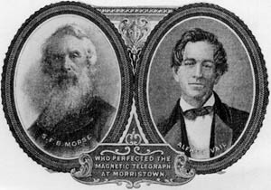
I. Introduction
Morse Code
Developed by Samuel F. B. Morse and Alfred Vail in 1838 to decode the message sent by their one-wire telegraph system [2].
The first version of Morse code showed deficiencies once it was used in Europe, since they did not account for the texts that has diacritics for the non-English languages in Europe [1].

Slide 3
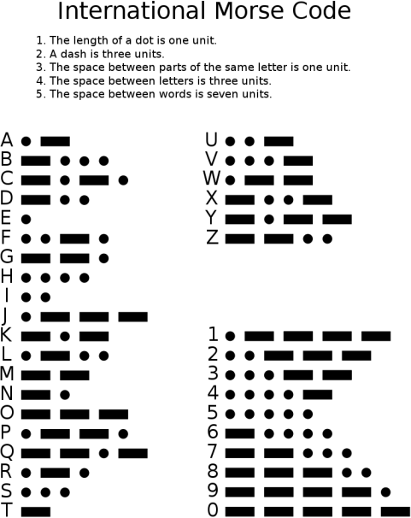
I. Introduction
In 1851 the conference of European nations developed a new version of American Morse Code and called it the International Morse Code. It defined constant length for dashes compared to the original Morse code [3].
A dot is equal to a unit
A dash is equal to three units
space between parts of the same letter is one unit
space between letters is three units
space between words is seven units

Slide 4
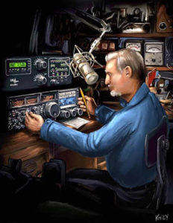
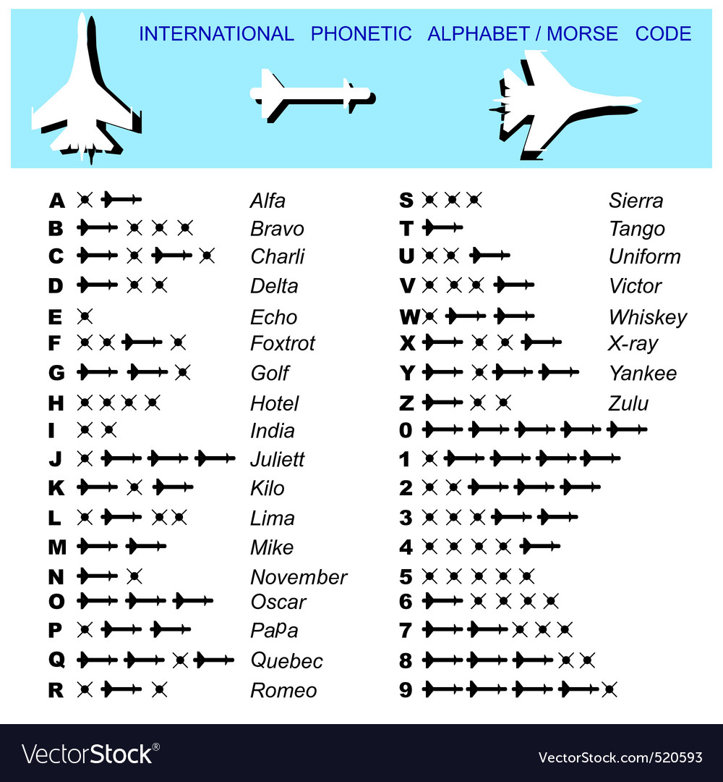
I. Introduction
Morse Code is still used this day by amateur radio enthusiasts, sectors such as aeronautical fields for their navigation, and even person with disabilities who use it as an alternative form of communication [4].

Slide 5
I. Introduction
To build and develop the Morse Code Translator the researchers will use Python as their programming language, and utilizing the native Tkinter library for the GUI.
To facilitate the flow of logic in converting Morse code to text and vice versa, the researchers will construct a Moore machine. Moore machines are finite state transducers developed by Edward Moore. For a given output Moore machine will generate an output depending on the current state of the machine [5].
This project will be limited only to the English alphabet which means it will not include any diacritics, numbers 0-9, and symbols “+”, “=”, and ‘/’.

Slide 6
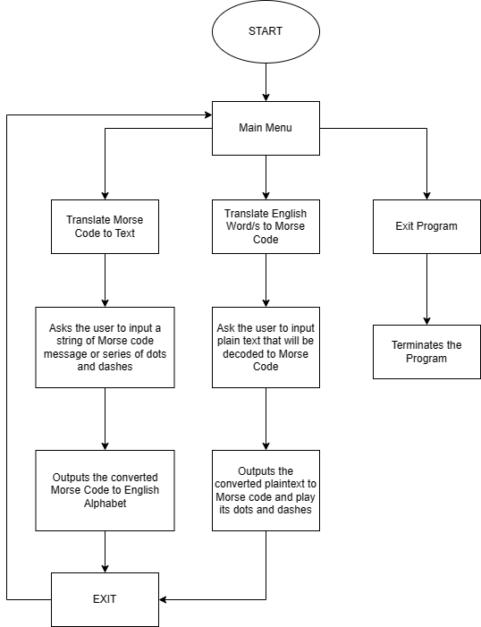
II. Developing The Morse Translator
Defining the Programs Functions
The development of the project starts by establishing what are the functions the program can do. Using flow chart, the specific functions are displayed and the flow of process.

Slide 7
II. Developing The Morse Translator
Translate Morse Code to Text
The logic process of translating Morse code to text is facilitated by the Moor machine. A finite state transducer that produces an output based from its states.
The Moore machine described in the context of this project is presented as follows:
Q = 43 states. {A-Z, 0-9, and symbols “+”, “=”, and “/”, 4 – ε-states}
q0 = S
∑ = {“.”, “-“}
O: {A-Z, 0-9, +, =, /, ε}

Slide 8
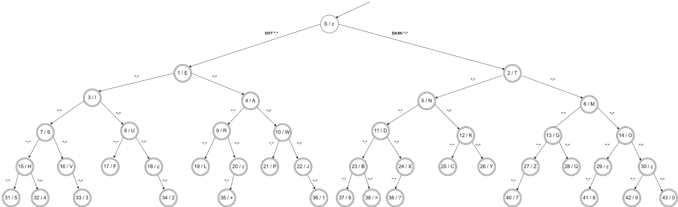
II. Developing The Morse Translator
Translate Morse Code to Text
Moore Machine representation:

Slide 9
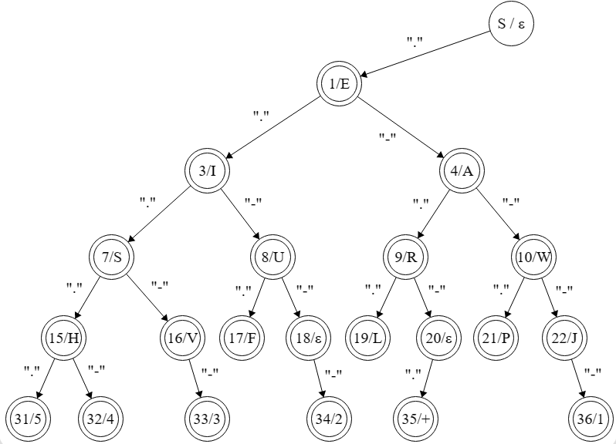
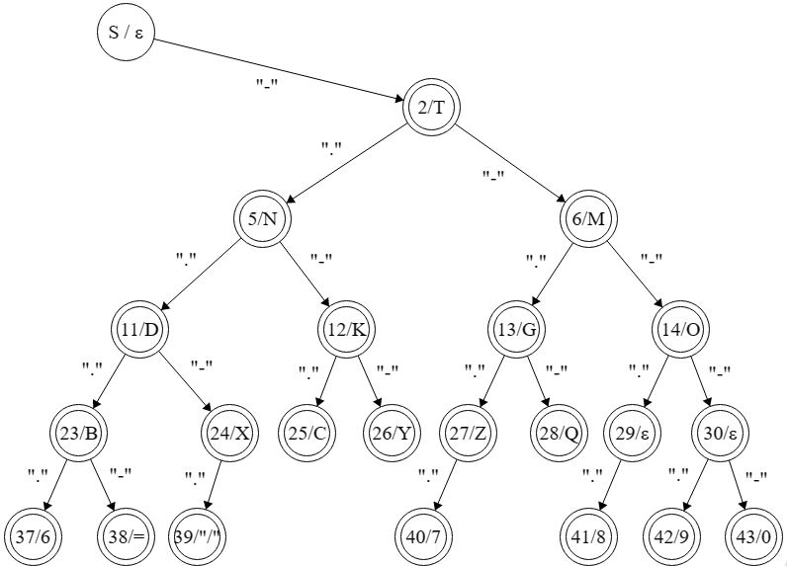
II. Developing The Morse Translator
Translate Morse Code to Text
For better clarity:
Moore Machine Left Side
Moore Machine Right Side

Slide 10
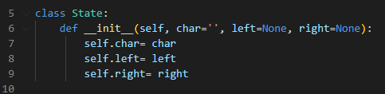
II. Developing The Morse Translator
Translate Morse Code to Text Python Implementation
To implement the Moore Machine into Python, a class declaration was called, and composed of self.char, self.left, and self.right this translates to:
class State = state
self.char = output character
self.left = transition function if the input was dot “.”
self.right = transition function if the input was dash “-”

Slide 11
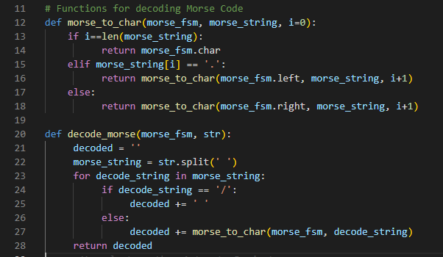
II. Developing The Morse Translator
Translate Morse Code to Text Python Implementation
The actual translation is described in the code below:

Slide 12
II. Developing The Morse Translator
Translate Morse Code to Text Python Implementation
Input Morse Code is split using spaces. To separate the corresponding Morse code strings to their respective characters.
If a ‘/’ was read a space was added since it means they are two different words.
Each dot “.” and dash “-” read will be input to the Moore class resulting to either state.left or state.right depending on the input.
Step 3 will repeat recursively until the end of the split Morse code string is read.
Once the end of Morse code string is read the corresponding character of the last state it visited will be returned.
The returned character will be appended to the variable that will contain the whole translated Morse Code string.
The whole process is repeated until no elements in the split Morse coded string remains.

Slide 13
II. Developing The Morse Translator
Translate English Word/s to Morse Code
Utilizing the already built Moore machine, each state contains a character output. This could be used if the input character is equal to the output character. The path or the state transitions taken to produce that output character will be returned as the translation of the input character to Morse Code. To visualize this better a pseudocode is presented:
Pseudocode:
Read each character of the input string.
In each iteration check if the current character in read is equal to the current output of the state.
If not move to another state and record the transition function.
Repeat step 3 until the input character is equal to the output character of the state.
The ∑ used in each transition function will now serve as the Morse Code translation of the input string.

Slide 14
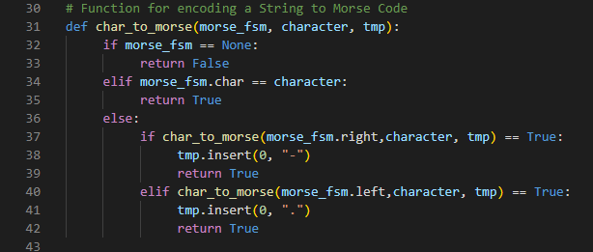
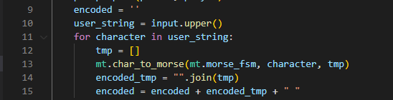
II. Developing The Morse Translator
Translate English Word/s to Morse Code Python Implementation
The Python implementation of the pseudocode also utilizes the already built Moore class. A code snippet is provided below:

Slide 15
II. Developing The Morse Translator
Translate English Word/s to Morse Code Python Implementation
Each character of the input string will be read using a for loop.
When a character is being read, a temporary variable will be declared which will be the temporary storage for the Morse code string of the current character being read.
Then it continuously finds the state where the character output is equal to the current character being read, while also recording the path it took to reach the state and storing it in the temporary variable.
Once the equal output character of a state is found the temporary variable containing the path taken to that state will be returned.
The returned string of dots and dashes is now the Morse code equivalent of the character that was read, and will be appended to a variable containing the whole translated input string added with a space “ ” to separate individual characters of the translated input string.
Once the final character of the input string was read the for loop breaks.

Slide 16
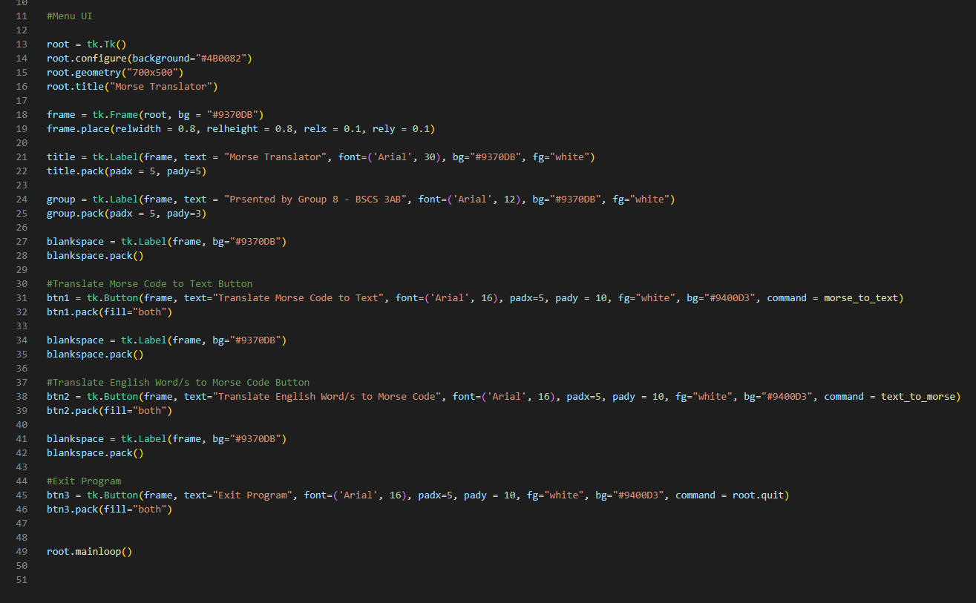
II. Developing The Morse Translator
Developing the GUI of the Project
Tkinter a native GUI library in Python, will be used to design the GUI of this project.
The code snippet displaying the main menu UI of this project is presented below:

Slide 17
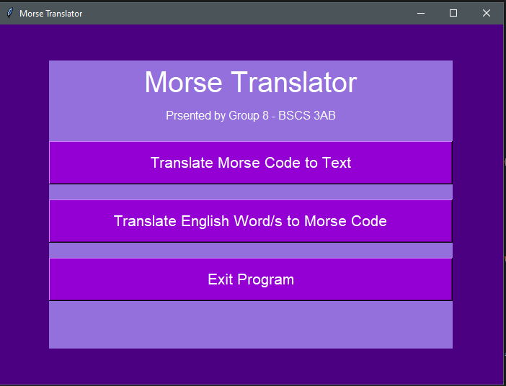
III. Results
Morse Translator UI
The developed Morse Translator UI is presented on the right:
It displays 3 buttons, Translate Morse Code to Text, Translate English Word/s to Morse, and Exit program

Slide 18
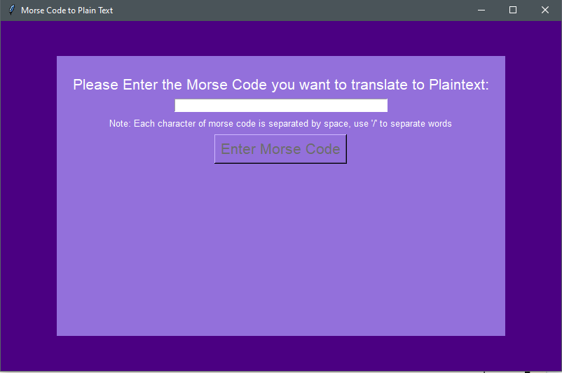
III. Results
Morse Code to Text
New window appears prompting the user to enter the Morse Code they want to translate in the text box.
The Enter Morse Code button will be inactive unless the text box is filled.

Slide 19
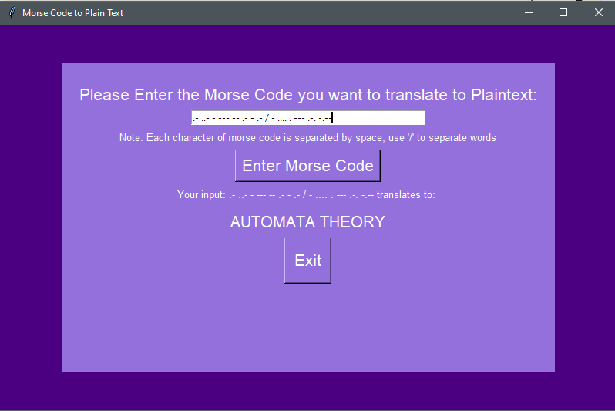
III. Results
Morse Code to Text
Words are separated by ‘/’
Once Enter Morse Code button was clicked the translated Morse code string will be displayed.
An exit button appears that will allow the user to return to the main menu.

Slide 20
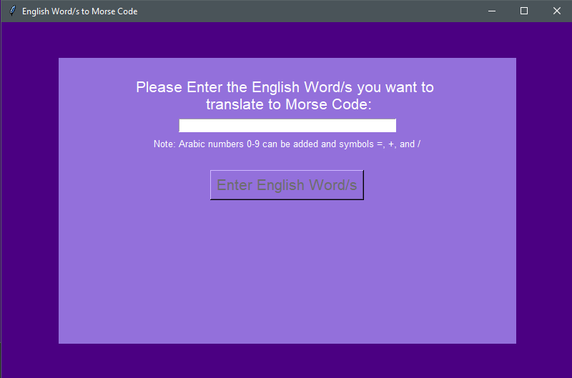
III. Results
English Word/s to Morse Code
New window appears to ask the user to input an English text string inside the text box
The Enter English Word/s button will be inactive until the text box is filled.

Slide 21
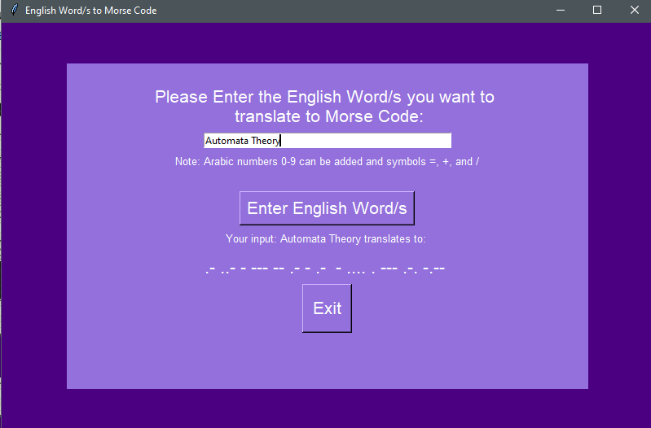
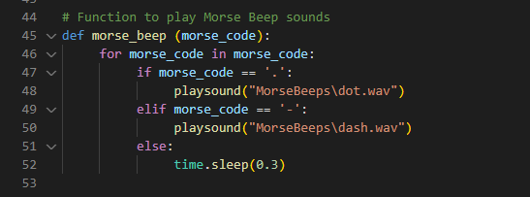
III. Results
English Word/s to Morse Code
Once Enter English Word/s button was clicked a beeping sound will be played that corresponds to the translated string. After that the translated string will be displayed.
An exit button appears that will allow the user to return to the main menu.

Slide 22
IV. Conclusions and Recommendations
Conclusions
This project displayed an application of a concept from Automata Theory, specifically Moore Machine, to translate Morse Code to English word/s and vice versa.
Morse Code is one of the most elegant and simple systems of communication as it only uses dots and dashes to convey a message and flexible in methods of transmission.
Morse code survived for decades and is still functionally usable especially in case of emergencies, which makes it a life-saving knowledge.

Slide 23
IV. Conclusions and Recommendations
Recommendations
Create a mobile application that can also do Morse Code transmission using the device’s native features. For example, blinking using its flashlight or screen, and/or beeping sounds.
Include a speech to Morse Code functionality.

Slide 24
Thank You!

